Slide 1
IMSE 991 Multiple Criteria Decision Making
Lecture 5
Analytic Hierarchy Process

Slide 2
Analytic Hierarchy Process
Developed by Saaty (1977, 1980)
Useful when decision maker is unable to construct a utility function
Need to have appropriate problem set up
Decision maker does not provide numerical judgement but a relative verbal appreciation
Need to check consistency
Can perform sensitivity analysis

Slide 3
Problem Structuring
Problem is structured according to a hierarchy
Top element – goal of the decision
Second level – decision criteria
Third level – alternatives
Example: Evaluate the location for a sports shop
Shopping center
City center
New industrial area

Slide 4
Problem Structuring
Example: Evaluate the location for a sports shop
Shopping center
City center
New industrial area
Criteria for shop location decision
Criterion | Explanation
Visibility | Probability that a random passer-by notices the shop
Competition | Level of competition in the area
Frequency | Average number of customers in similar shops in the area
Rental cost | Average rental cost by square meter

Slide 5
Problem Structuring
Hierarchy of decision levels for case study
Level 1
Location of a sports shop
Visibility
Industrial area
Competition
Industrial area
Shopping center
City center
Shopping center
City center
Frequency
Industrial area
Shopping center
City center
Rental cost
Industrial area
Shopping center
City center
Level 2
Level 3

Slide 6
Problem Structuring
Each lower level is prioritized according to its immediate upper level
Level 2: “Which criterion is most important for choosing the location of a sports shop and to what extent?”
Level 3: “Which alternative is preferable to fulfil the given criterion and to what extent?”

Slide 7
Priority Calculation
A priority is a score that ranks the importance of the alternative or criterion in the decision
Criteria priorities: Importance of each criterion (with respect to the top goal)
Local alternative priorities: Importance of an alternative with respect to one specific criterion

Slide 8
Priority Calculation
A priority is a score that ranks the importance of the alternative or criterion in the decision
Global alternative priorities: Priority criteria and local all alternative priorities are intermediate results used to calculate the global alternative priorities
Global alternative priorities rank alternatives with respect to the overall goal

Slide 9
Fundamental Steps
Develop the ratings for each decision alternative for each criterion by
Developing the pairwise comparison matrix
Normalizing the resulting matrix
Averaging the values in each row to get the corresponding rating
Calculating and checking the consistency ratio

Slide 10
Fundamental Scale
AHP uses a pairwise comparison
Each alternative is evaluated against the other alternatives
Typically a 1 – 9 scale is used to measure the degree of importance
Degree of importance | Definition
1 | Equal Importance
2 | Weak
3 | Moderate importance
4 | Moderate plus
5 | Strong importance
6 | Strong plus
7 | Very strong or demonstrated importance
8 | Very, very strong
9 | Extreme importance

Slide 11
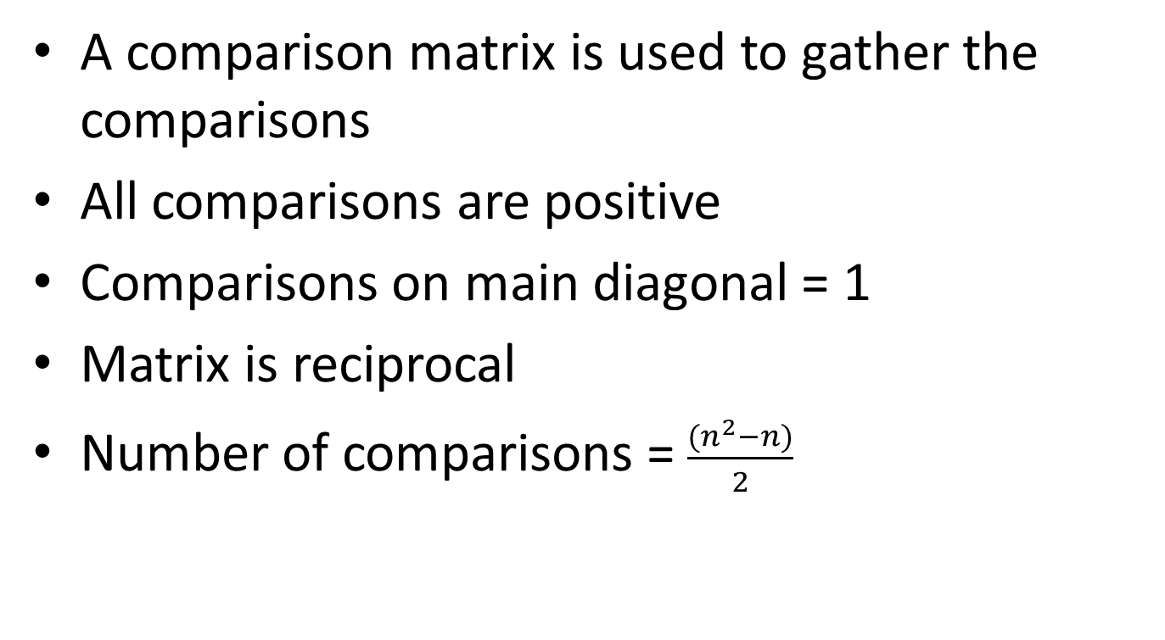
Fundamentals of AHP
A comparison matrix is used to gather the comparisons
All comparisons are positive
Comparisons on main diagonal = 1
Matrix is reciprocal
Number of comparisons = $\frac{{(n}^{2}−n)}{2}$

Slide 12
AHP Example
Criteria definition
Criteria for shop location decision
Criterion | Explanation
Visibility | Probability that a random passer-by notices the shop
Competition | Level of competition in the area
Frequency | Average number of customers in similar shops in the area
Rental cost | Average rental cost by square meter

Slide 13
Criteria Evaluation
Criteria evaluation
Comparisons ask 2 questions:
Which is more important with respect to the criterion?
How strongly?
The decision matrix captures this information

Slide 14
Example Evaluation
Criteria evaluation
Example 1
Competition is more important than Visibility
Intensity of the importance is Moderate plus = 4
Example 2
Visibility is more important than Renting costs
Intensity of the importance is Weak = 2
 | Visibility | Competition | Frequency | Renting costs
Visibility | 1 | 1/4 | 1/5 | 2
Competition | 4 | 1 | 1/2 | 1
Frequency | 5 | 2 | 1 | 4
Renting costs | 1/2 | 1 | 1/4 | 1
Note: Inverse Relationships

Slide 15
AHP Solution Methods
There are three primary methods used to generate the AHP solution
Eigenvalue Method
Approximate Method
Geometric Mean

Slide 16
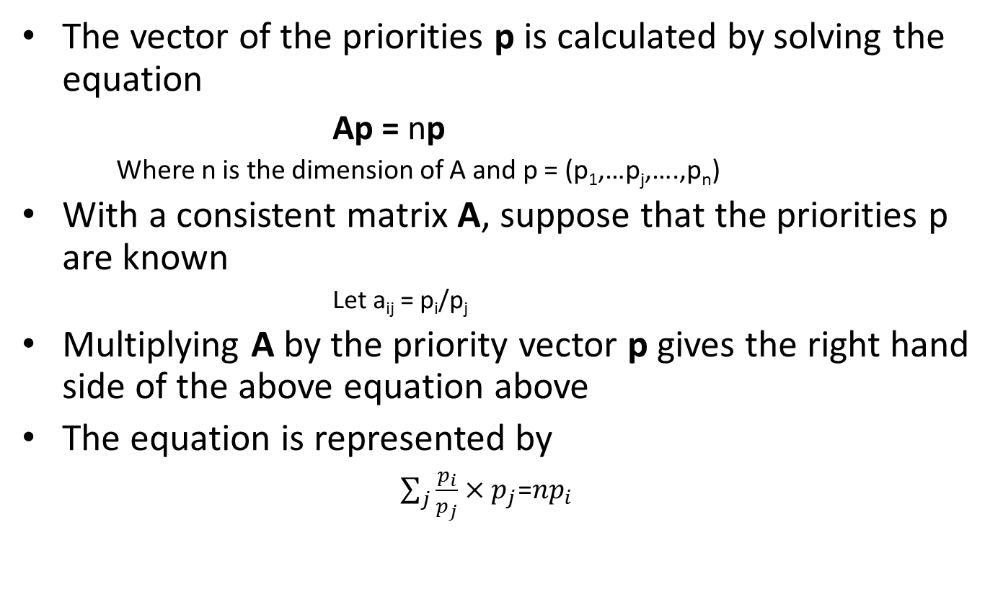
Eigenvector Method
The vector of the priorities p is calculated by solving the equation
Ap = np
Where n is the dimension of A and p = (p₁,…p_{j},….,p_{n})
With a consistent matrix A, suppose that the priorities p are known
Let a_{ij} = p_{i}/p_{j}
Multiplying A by the priority vector p gives the right hand side of the above equation above
The equation is represented by
$\sum_{j}{\frac{p_{i}}{p_{j}}}×p_{j}$=$np_{i}$

Slide 17
Example Decision Matrix
The Decision Matrix captures the pairwise comparisons
 | Visibility | Competition | Frequency | Renting costs
Visibility | 1 | 1/4 | 1/5 | 2
Competition | 4 | 1 | 1/2 | 1
Frequency | 5 | 2 | 1 | 4
Renting costs | 1/2 | 1 | 1/4 | 1

Slide 18
Eigenvector Method
Raise the pairwise matrix to powers that are successively squared each time
Row sums are tabulated and normalized
Process stops when the difference between the sums of the tabulated comparisons are less than a prescribed value

Slide 19
Squaring the Matrix
Squaring the matrix
 | Visibility | Competition | Frequency | Renting costs
Visibility | 1 | 1/4 | 1/5 | 2
Competition | 4 | 1 | 1/2 | 1
Frequency | 5 | 2 | 1 | 4
Renting costs | 1/2 | 1 | 1/4 | 1
X
 | Visibility | Competition | Frequency | Renting costs
Visibility | 1 | 1/4 | 1/5 | 2
Competition | 4 | 1 | 1/2 | 1
Frequency | 5 | 2 | 1 | 4
Renting costs | 1/2 | 1 | 1/4 | 1
1*1 + 1*1/4 + 1/5*5 + 2*1/2 = 4.000
 | Visibility | Competition | Frequency | Renting costs
Visibility | 4.000 | 2.900 | 1.025 | 5.050
Competition | 11.000 | 4.000 | 2.050 | 12.000
Frequency | 20.000 | 9.250 | 4.000 | 20.000
Renting costs | 6.250 | 2.625 | 1.100 | 4.000
Squared Matrix

Slide 20
Computing the Eigenvector
Sum the rows
Normalize the values by dividing the row sums by the total
 | Visibility | Competition | Frequency | Renting costs | Sum of the rows | Eigenvector
Visibility | 4.000 | 2.900 | 1.025 | 5.050 | 12.975 | 0.1188
Competition | 11.000 | 4.000 | 2.050 | 12.000 | 29.050 | 0.2659
Frequency | 20.000 | 9.250 | 4.000 | 20.000 | 53.250 | 0.4874
Renting costs | 6.250 | 2.625 | 1.100 | 4.000 | 13.975 | 0.1279
 |  |  |  |  | 109.250 | 1.0000

Slide 21
Second Iteration
Repeat squaring the matrix, summing the rows and normalizing the values until an acceptable value
 | Visibility | Competition | Frequency | Renting costs
Visibility | 4.000 | 2.900 | 1.025 | 5.050
Competition | 11.000 | 4.000 | 2.050 | 12.000
Frequency | 20.000 | 9.250 | 4.000 | 20.000
Renting costs | 6.250 | 2.625 | 1.100 | 4.000
1st iteration matrix
Stop: Difference OK
4*4 + 2.9*11 + 1.025*20 + 5.05*6.25 = 99.963
 | Visibility | Competition | Frequency | Renting costs | Sum of the rows | Eigenvector
Visibility | 99.963 | 45.938 | 19.700 | 95.700 | 261.300 | 0.1250
Competition | 204.000 | 98.363 | 40.875 | 192.550 | 535.788 | 0.2564
Frequency | 386.750 | 184.500 | 77.463 | 372.000 | 1020.713 | 0.4885
Renting costs | 100.875 | 49.300 | 20.588 | 101.063 | 271.825 | 0.1301
 |  |  |  |  | 2089.625 | 1.0000
Result

Slide 22
Stopping
Process stops when the difference between the sums of the tabulated comparisons are less than a prescribed value
 | Visibility | Competition | Frequency | Renting costs | Sum of the rows | Eigenvector
Visibility | 4.000 | 2.900 | 1.025 | 5.050 | 12.975 | 0.1188
Competition | 11.000 | 4.000 | 2.050 | 12.000 | 29.050 | 0.2659
Frequency | 20.000 | 9.250 | 4.000 | 20.000 | 53.250 | 0.4874
Renting costs | 6.250 | 2.625 | 1.100 | 4.000 | 13.975 | 0.1279
 |  |  |  |  | 109.250 | 1.0000
Iteration 1
 | Visibility | Competition | Frequency | Renting costs | Sum of the rows | Eigenvector
Visibility | 99.963 | 45.938 | 19.700 | 95.700 | 261.300 | 0.1250
Competition | 204.000 | 98.363 | 40.875 | 192.550 | 535.788 | 0.2564
Frequency | 386.750 | 184.500 | 77.463 | 372.000 | 1020.713 | 0.4885
Renting costs | 100.875 | 49.300 | 20.588 | 101.063 | 271.825 | 0.1301
 |  |  |  |  | 2089.625 | 1.0000
Iteration 2

Slide 23
Relative Importance of Decision Criteria
Relative Importance
 | Eigenvector | Rank
Visibility | 0.1250 | 4
Competition | 0.2564 | 2
Frequency | 0.4885 | 1
Renting costs | 0.1301 | 3

Slide 24
Hierarchical Tree
Relative Importance of Decision Criteria
Location of a sports shop
Visibility (0.1250)
Industrial area
Competition (0.2564)
Industrial area
Shopping center
City center
Shopping center
City center
Frequency (0.4885)
Industrial area
Shopping center
City center
Rental cost (0.1301)
Industrial area
Shopping center
City center

Slide 25
Priority of Alternatives
Repeat the process for the alternatives
Each alternative should be evaluated in relationship to the decision criteria
For example, first preform the pairwise comparison for the Industrial Center, Shopping Center and City Center in relationship to Visibility.
Do the same for the three other criteria

Slide 26
Priority of Alternatives - Competition
Pairwise comparison of Competition
 | Industrial area | City centre | Shopping centre
Industrial area | 1 | 6 | 3
City centre | 1/6 | 1 | 1/2
Shopping centre | 1/3 | 2 | 1
 | Industrial area | City centre | Shopping centre | Sum of Rows | Eigenvector
Industrial area | 3.00 | 18.00 | 9.00 | 30.00 | 0.6667
City centre | 0.50 | 3.00 | 1.50 | 5.00 | 0.1111
Shopping centre | 1.00 | 6.00 | 3.00 | 10.00 | 0.2222
 |  |  |  | 45.00
 | Industrial area | City centre | Shopping centre | Sum of Rows | Eigenvector
Industrial area | 27.00 | 162.00 | 81.00 | 270.00 | 0.6667
City centre | 4.50 | 27.00 | 13.50 | 45.00 | 0.1111
Shopping centre | 9.00 | 54.00 | 27.00 | 90.00 | 0.2222
 |  |  |  | 405.00
Local Priorities | Competition
Industrial area | 0.6667
City centre | 0.1111
Shopping centre | 0.2222
 | 1.0000

Slide 27
Priority of Alternatives - Visibility
Pairwise comparison of Visibility
 | Industrial area | City centre | Shopping centre
Industrial area | 1 | 1/5 | 1/5
City centre | 5 | 1 | 1/2
Shopping centre | 5 | 2 | 1
 | Industrial area | City centre | Shopping centre | Sum of Rows | Eigenvector
Industrial area | 3.00 | 0.80 | 0.50 | 4.30 | 0.0863
City centre | 12.50 | 3.00 | 2.00 | 17.50 | 0.3514
Shopping centre | 20.00 | 5.00 | 3.00 | 28.00 | 0.5622
 |  |  |  | 49.80
 | Industrial area | City centre | Shopping centre | Sum of Rows | Eigenvector
Industrial area | 29.00 | 7.30 | 4.60 | 40.90 | 0.0888
City centre | 115.00 | 29.00 | 18.25 | 162.25 | 0.3522
Shopping centre | 182.50 | 46.00 | 29.00 | 257.50 | 0.5590
 |  |  |  | 460.65
Local Priorities | Visibility
Industrial area | 0.0888
City centre | 0.3522
Shopping centre | 0.5590
 | 1.0000

Slide 28
Priority of Alternatives - Frequency
Pairwise comparison of Frequency
 | Industrial area | City centre | Shopping centre
Industrial area | 1 | 1/4 | 1/5
City centre | 4 | 1 | 1/3
Shopping centre | 5 | 3 | 1
 | Industrial area | City centre | Shopping centre | Sum of Rows | Eigenvector
Industrial area | 3.00 | 1.10 | 0.48 | 4.58 | 0.0899
City centre | 9.67 | 3.00 | 1.47 | 14.13 | 0.2773
Shopping centre | 22.00 | 7.25 | 3.00 | 32.25 | 0.6328
 |  |  |  | 50.97
 | Industrial area | City centre | Shopping centre | Sum of Rows | Eigenvector
Industrial area | 30.27 | 10.10 | 4.51 | 44.88 | 0.0937
City centre | 90.27 | 30.27 | 13.47 | 134.01 | 0.2798
Shopping centre | 202.08 | 67.70 | 30.27 | 300.05 | 0.6265
 |  |  |  | 478.94
Local Priorities | Frequency
Industrial area | 0.0937
City centre | 0.2798
Shopping centre | 0.6265
 | 1.0000

Slide 29
Priority of Alternatives – Rental Costs
Pairwise comparison of Rental Costs
 | Industrial area | City centre | Shopping centre
Industrial area | 1 | 1/7 | 1/5
City centre | 7 | 1 | 1/5
Shopping centre | 5 | 5 | 1
 | Industrial area | City centre | Shopping centre | Sum of Rows | Eigenvector
Industrial area | 3.00 | 1.29 | 0.43 | 4.71 | 0.0566
City centre | 15.00 | 3.00 | 1.80 | 19.80 | 0.2379
Shopping centre | 45.00 | 10.71 | 3.00 | 58.71 | 0.7055
 |  |  |  | 83.23
 | Industrial area | City centre | Shopping centre | Sum of Rows | Eigenvector
Industrial area | 47.57 | 12.31 | 4.89 | 64.76 | 0.0719
City centre | 171.00 | 47.57 | 17.23 | 235.80 | 0.2617
Shopping centre | 430.71 | 122.14 | 47.57 | 600.43 | 0.6664
 |  |  |  | 900.99
Local Priorities | Rental Costs
Industrial area | 0.0719
City centre | 0.2617
Shopping centre | 0.6664
 | 1.0000

Slide 30
Hierarchical Tree
Relative Importance of Alternatives and Criteria
Location of a sports shop
Visibility (0.1250)
Industrial area (0.0888)
Competition (0.2564)
Industrial area (0.6667)
Shopping center (0.5590)
City center (0.3522)
Shopping center (0.2222)
City center (0.1111)
Frequency (0.4885)
Industrial area (0.0937)
Shopping center (0.6265)
City center (0.2798)
Rental cost (0.1301)
Industrial area (0.0719)
Shopping center (0.6664)
City center (0.2617)
This contains the priorities of the attributes and the priorities of the alternatives in respect to each of the attributes.

Slide 31
Compute Global Priorities
Global Priorities are computed by multiplying the local priorities by the global priorities for each of the alternatives
Compute Global Priorities
 | Criteria Priorities
Competition | 0.2564
Visibility | 0.1250
Frequency | 0.4885
Renting costs | 0.1301
Local Priorities
 | Competition | Visibility | Frequency | Rental Costs | Local x Global | Preference
Industrial area | 0.6667 | 0.0888 | 0.0937 | 0.0719 | 0.2372
City centre | 0.1111 | 0.3522 | 0.2798 | 0.2617 | 0.2432
Shopping centre | 0.2222 | 0.5590 | 0.6265 | 0.6664 | 0.5196 | 1st

Slide 32
Approximation Method
Decision Criteria Priorities
1) Compare pairwise the importance of each criteria as regard to the goal
 | Visibility | Competition | Frequency | Renting costs
Visibility | 1 | 1/4 | 1/5 | 2
Competition | 4 | 1 | 1/2 | 1
Frequency | 5 | 2 | 1 | 4
Renting costs | 1/2 | 1 | 1/4 | 1
2) Sum the rows and normalize
 | Visibility | Competition | Frequency | Renting costs | Sum of the rows | Normalized Sum
Visibility | 1.000 | 0.250 | 0.200 | 2.000 | 3.450 | 0.1397
Competition | 4.000 | 1.000 | 0.500 | 1.000 | 6.500 | 0.2632
Frequency | 5.000 | 2.000 | 1.000 | 4.000 | 12.000 | 0.4858
Renting costs | 0.500 | 1.000 | 0.250 | 1.000 | 2.750 | 0.1113
 |  |  |  |  | 24.700 | 1.0000

Slide 33
Approximation Method
Pairwise Comparison of Competition
 | Industrial area | City centre | Shopping centre
Industrial area | 1 | 6 | 3
City centre | 1/6 | 1 | 1/2
Shopping centre | 1/3 | 2 | 1
 | Industrial area | City centre | Shopping centre | Sum of Rows | Normalized Sum
Industrial area | 1.0000 | 6.0000 | 3.0000 | 10.00 | 0.6667
City centre | 0.1667 | 1.0000 | 0.5000 | 1.67 | 0.1111
Shopping centre | 0.3333 | 2.0000 | 1.0000 | 3.33 | 0.2222
 |  |  |  | 15.00
Local Priorities | Competition
Industrial area | 0.6667
City centre | 0.1111
Shopping centre | 0.2222
 | 1.0000

Slide 34
Approximation Method
Pairwise Comparison of Visibility
 | Industrial area | City centre | Shopping centre
Industrial area | 1 | 1/5 | 1/5
City centre | 5 | 1 | 1/2
Shopping centre | 5 | 2 | 1
 | Industrial area | City centre | Shopping centre | Sum of Rows | Normalized Sum
Industrial area | 1.0000 | 0.2000 | 0.2000 | 1.40 | 0.0881
City centre | 5.0000 | 1.0000 | 0.5000 | 6.50 | 0.4088
Shopping centre | 5.0000 | 2.0000 | 1.0000 | 8.00 | 0.5031
 |  |  |  | 15.90
Local Priorities | Visibility
Industrial area | 0.0881
City centre | 0.4088
Shopping centre | 0.5031
 | 1.0000

Slide 35
Approximation Method
Pairwise Comparison of Frequency
 | Industrial area | City centre | Shopping centre
Industrial area | 1 | 1/4 | 1/5
City centre | 4 | 1 | 1/3
Shopping centre | 5 | 3 | 1
 | Industrial area | City centre | Shopping centre | Sum of Rows | Normalized Sum
Industrial area | 1.0000 | 0.2500 | 0.2000 | 1.45 | 0.0919
City centre | 4.0000 | 1.0000 | 0.3333 | 5.33 | 0.3379
Shopping centre | 5.0000 | 3.0000 | 1.0000 | 9.00 | 0.5702
 |  |  |  | 15.78
Local Priorities | Frequency
Industrial area | 0.0919
City centre | 0.3379
Shopping centre | 0.5702
 | 1.0000

Slide 36
Approximation Method
Pairwise Comparison of Rental Costs
 | Industrial area | City centre | Shopping centre
Industrial area | 1 | 1/7 | 1/5
City centre | 7 | 1 | 1/5
Shopping centre | 5 | 5 | 1
 | Industrial area | City centre | Shopping centre | Sum of Rows | Normalized Sum
Industrial area | 1.0000 | 0.1429 | 0.2000 | 1.34 | 0.0654
City centre | 7.0000 | 1.0000 | 0.2000 | 8.20 | 0.3992
Shopping centre | 5.0000 | 5.0000 | 1.0000 | 11.00 | 0.5355
 |  |  |  | 20.54
Local Priorities | Rental Costs
Industrial area | 0.0654
City centre | 0.3992
Shopping centre | 0.5355
 | 1.0000

Slide 37
Approximation Method
Global and Local Priorities
Compute Global Priorities
 | Criteria Priorities
Competition | 0.2632
Visibility | 0.1397
Frequency | 0.4858
Renting costs | 0.1113
Local Priorities
 | Competition | Visibility | Frequency | Rental Costs | Local x Global | Preference
Industrial area | 0.6667 | 0.0881 | 0.0919 | 0.0654 | 0.2396
City centre | 0.1111 | 0.4088 | 0.3379 | 0.3992 | 0.2949
Shopping centre | 0.2222 | 0.5031 | 0.5702 | 0.5355 | 0.4654 | 1st

Slide 38
Geometric Mean
Definition of the Geometric Mean
Procedure:
Compare pairwise the importance of each criteria as regard to the goal
Calculate the geometric mean of the rows
Normalize the geometric mean = criteria priorities
Limitation: lacks measure of consistency

Slide 39
Geometric Mean
Decision Criteria Priorities
 | Visibility | Competition | Frequency | Renting costs
Visibility | 1 | 1/4 | 1/5 | 2
Competition | 4 | 1 | 1/2 | 1
Frequency | 5 | 2 | 1 | 4
Renting costs | 1/2 | 1 | 1/4 | 1
 | Visibility | Competition | Frequency | Renting costs | Geometric Mean | Criteria Priorities
Visibility | 1.000 | 0.250 | 0.200 | 2.000 | 0.5623 | 0.1157
Competition | 4.000 | 1.000 | 0.500 | 1.000 | 1.1892 | 0.2446
Frequency | 5.000 | 2.000 | 1.000 | 4.000 | 2.5149 | 0.5174
Renting costs | 0.500 | 1.000 | 0.250 | 1.000 | 0.5946 | 0.1223
 |  |  |  |  | 4.8610

Slide 40
Geometric Mean Method
Global and Local Priorities
Compute Global Priorities
 | Criteria Priorities
Competition | 0.2446
Visibility | 0.1157
Frequency | 0.5174
Renting costs | 0.1223
Local Priorities
 | Competition | Visibility | Frequency | Rental Costs | Local x Global | Preference
Industrial area | 0.6664 | 0.0889 | 0.0938 | 0.0704 | 0.2304
City centre | 0.1113 | 0.3522 | 0.2798 | 0.2574 | 0.2442
Shopping centre | 0.2224 | 0.5589 | 0.6264 | 0.6722 | 0.5254 | 1st

Slide 41
Global and Local Priorities By Method
Eigenvalue Method
Approximation Method
Closest
Scores
Geometric Mean Method

Slide 42
Consistency
Ratings should be consistent in two ways:
Ratings should be transitive
That means that
If A is better than B and B is better than C, then A must be better than C
Ratings should be numerically consistent

Slide 43
Weights for Inconsistent Matrices
Eigenvalue/Eigenvector Method
Eigenvalues are important tools in several math, science and engineering applications for changing coordinate systems, solving differential equations, statistical applications
Defined as follows: for square matrix A and vector x,
λ = Eigenvalue of A when Ax = λx, x nonzero
x is then the eigenvector associated with λ
Compute by solving the characteristic equation:
det(λI – A) = | λI – A | = 0

Slide 44
Weights for Inconsistent Matrices
Properties:
The number of nonzero Eigenvalues for a matrix is equal to its rank (a consistent matrix has rank 1)
The sum of the Eigenvalues equals the sum of the diagonal elements of the matrix (all 1’s for consistent matrix)
Therefore: A n x n consistent matrix has one Eigenvalue with value n
Knowing this will provide a basis of determining consistency
Inconsistent matrices typically have more than 1 eigen value
We will use the largest, λ_{max} for the computation

Slide 45
Consistency
Compute the Eigenvalues for the inconsistent matrix
– Must solve: Aw = λw by solving det(λI – A) = 0
– We get:
λ
= 4.3927
max
Compare with λ from inconsistent matrix
Use test statistic:
max
max

Slide 46
Consistency
 | Visibility | Competition | Frequency | Renting costs | Eigenvector | Aw | lambda_{max}
Visibility | 1 | 1/4 | 1/5 | 2 | 0.1250 | 0.5470 | 4.3744
Competition | 4 | 1 | 1/2 | 1 | 0.2564 | 1.1309 | 4.4106
Frequency | 5 | 2 | 1 | 4 | 0.4885 | 2.1468 | 4.3951
Renting costs | 1/2 | 1 | 1/4 | 1 | 0.1301 | 0.5711 | 4.3905
 |  |  |  |  |  |  | 4.3927
0.1309= Consistency Index
max
Order of Matrix | 1 | 2 | 3 | 4 | 5 | 6 | 7 | 8 | 9 | 10
Random | 0.00 | 0.00 | 0.58 | 0.90 | 1.12 | 1.24 | 1.32 | 1.41 | 1.45 | 1.49
0.1309 < 0.90 – Fairly Consistent

Slide 47
Team Presentations

Slide 48
IMSE 991 Multiple Criteria Decision Making
Lecture 5
Analytic Hierarchy Process

